Slide 1
Report to the Texas Tech System Board of Regents
M. Duane Nellis
President, Texas Tech University
March 05, 2015

Slide 2
Texas Tech University Strategic Priorities
Increase Enrollment and Promote Student Success
Strengthen Academic Quality and Reputation
Expand and Enhance Research and Creative Scholarship
Further Outreach and Engagement
Increase and Maximize Resources

Slide 3
Goals to be more AAU-like
AAU characteristics
Competitively funded federal research reported by NSF
USDA, state, and industrial research funding
Faculty membership in the National Academies
National Research Council rankings of faculty quality
Faculty awards and honors tracked by AAU and CMUP*
Citations measuring both research volume and quality
Number of Ph.D.s granted annually
Number of postdoctoral appointees
Undergraduate education – input and output variables in undergraduate programs
*The Center for Measuring University Performance
Notes:
How often do they rank?

Slide 4
2014 Accomplishments
Increase Enrollment and Promote Student Success
3.0% average annual undergraduate enrollment increase since 2010
Increased freshmen enrollment by 17.5% from 2013-2014
Increased graduate enrollment by 8.4% from 2013-2014
Increased international enrollment by 22%
A 2.25% annual enrollment increase with enhanced retention rate will reach 40,000 by 2020
First year retention has increased by 2.8% in last two years.
Established TTU Worldwide eLearning to increase the accessibility and quality of online courses and degree programs
Strengthen Academic Quality and Reputation
Recruitment of high quality students while maintaining progress toward becoming HSI through enhanced scholarship awards
Continued to focus on becoming more AAU-like
Continue to monitor attainment of benchmarks utilized by the AAU, CMUP and NRC
Hiring high quality faculty
Identifying more faculty for national awards
Enhance number of post-docs
Enhanced faculty retention strategies through flight-risk and merit increases
Increased recruitment efforts for graduate students through new stipend enhancements
Enhance recruitment of top graduate students by increasing support from both institutional funds and external research

Slide 5
2014 Accomplishments, cont’d
Expand and Enhance Research and Creative Scholarship
Growth trends occurred in 2014 through enhanced faculty productivity – increases of:
15% Restricted Research
25% Awards
19% Proposals
Total research expenditures were up by over $16M to $154M, a 12% increase
FY2015 data show a strong rate of growth in research funding is continuing
Research Park was approved, Board of Directors appointed, and is scheduled to open in summer 2015
First tenant – Chromatin
Recognition as an Innovative and Economic Prosperity University by APLU
Texas Tech has won a $13M award from the Texas Emerging Technologies Fund to develop a national-scale research and certification facility
Further Outreach and Engagement
Appointment of Dr. Jennifer Bard to help coordinate documentation of community engagement activity
Refinement of survey instrument to more accurately capture outreach and engagement
Establish new expectations related to international engagement
Development of new outreach and engagement recognitions and award

Slide 6
2014 Accomplishments, cont’d
Increase and Maximize Resources
Implemented an incentivizing budget model to increase graduate and online enrollment
Continued to invest in highly productive faculty with a proactive retention program by providing mid-year retention awards
Continued to maximize space utilization through comprehensive review of research, teaching and office space and vetting of new requests through Space Allocation Committee for global review
Enhanced services and sustainability efforts and generate alternative revenues, including new Food Truck and Shredding Service
Maintained low administrative cost as a percentage of operating budget and lower utility costs through energy efficiency enhancements

Slide 7
Enrollment Growth & Student Success

Slide 8
TTU Enrollment Growth
*Conservative enrollment growth of 2.25% per year.
Notes:
Highlight the fact that our goal has been to grow our undergraduates to 32,000.
Spring 2015 enrollment is above 32,000 for the first time.

Slide 9
Student Retention Initiatives
Student Success & Retention (SSR) office – multiple efforts through Provost task force to promote student success through data mining and trend analysis, includes funding for Education Advisory Board (EAB) Student Success Collaborative contract
Red Raider Orientation, convocation, Raider Welcome – serve as recruitment, enrollment and college transition events
Support Operations for Academic Retention (SOAR) – provides peer tutoring and academic intervention, especially in courses with historically high rates of D and F grades
Pegasus Program – seeks to make exploration, innovation and academic success attainable for First Generation College students
Mentor Tech – enhances quality of education experiences with students from underrepresented groups through programs, services, advocacy and campus and community involvement
RaiderReady Freshman Seminar – course designed to assist new first time college students to manage the transition from high school to Texas Tech
Center for Active Learning and Undergraduate engagement (CALUE) -- supports undergraduate participation in active learning, including service learning, undergraduate research, internships and study abroad

Slide 10
Average SAT Scores of Entering Freshmen Class

Slide 11
Student to Faculty Ratio
College of Business Administration¹ | Fall 2010 | Fall 2011 | Fall 2012 | Fall 2013 | Fall 2014
Student FTE Per Faculty FTE² | 23 | 23 | 23 | 24 | 24
Students Per Faculty FTE³ | 43 | 43 | 42 | 41 | 45
College of Engineering¹ | Fall 2010 | Fall 2011 | Fall 2012 | Fall 2013 | Fall 2014
Student FTE Per Faculty FTE² | 17 | 19 | 18 | 17 | 19
Students Per Faculty FTE³ | 28 | 32 | 32 | 32 | 35
TTU¹ | Fall 2010 | Fall 2011 | Fall 2012 | Fall 2013 | Fall 2014
Student FTE Per Faculty FTE² | 23 | 23 | 23 | 22 | 23
Students Per Faculty FTE³ | 25 | 26 | 25 | 24 | 25
TTU (IPEDS)⁴ | Fall 2010 | Fall 2011 | Fall 2012 | Fall 2013 | Fall 2014
Student-to-Faculty Ratio | 23:1 | 24:1 | 24:1 | 20:1 | 22:1
1 - IPEDS definition does not work on breakdown of data by college; therefore, Provost’s college metrics have been used. 2 - Student full-time equivalents based on credit hours taught per faculty full-time equivalent 3 - Students enrolled in the college per faculty full-time equivalent 4 - IPEDS information based on the headcount of full-time faculty and students plus one-third of the part-time faculty and students. This ratio excludes the Law School

Slide 12
Growth in Undergraduate Hispanic FTE
Undergraduate Hispanic FTE and Total Undergraduate FTE
 | Fall 2011 |  | Fall 2012 |  | Fall 2013 |  | Fall 2014 |  | Projected Fall 2015¹ |  | Projected Fall 2016¹
 | FTE | Hispanic % | FTE | Hispanic % | FTE | Hispanic % | FTE | Hispanic % | FTE | Hispanic % | FTE | Hispanic %
Hispanic | 4,321 | 18% | 4,697 | 19% | 5,194 | 21% | 5,845 | 22% | 6,465 | 23% | 7,150 | 25%
Total | 24,323 |  | 24,647 |  | 25,240 |  | 26,603 |  | 28,040 |  | 28,895
1 - Assumes 3-year average growth rate will continue at 10.6% for Hispanic and 3% for total undergraduate FTE. This will add 1,305 additional Hispanic FTE.

Slide 13
Student Success Challenges
Maximize national and international student recognitions (Fulbrights, Goldwater/Gates/Rhodes, Trumans, Udalls, etc.)
Recruitment of top tier students (need competitive scholarships), improve retention and graduation rates
Increase graduate student support and enhanced graduate programs
Build national reputation
Competitive stipends
Greater faculty success toward higher National Research Council rankings
Greater student body diversity (HSI, international, study abroad)

Slide 14
Student Success Challenges, cont’d
Specialized student housing – Living Learning Communities
Scholarships and need-based aid
National merit scholarships will require $24K/student annually
Investment of $1.5M needed to increase graduate support to AAU level of 40% graduate students (currently at 30%)
Enhance advising strategies
Enhance admission standards

Slide 15
Academic Quality

Slide 16
Academic Challenges
Increase number of faculty to maintain student/faculty ratio
Additional staff
Retain faculty
National and International faculty recognitions (National Academy, AAAS Fellows, Fulbrights, etc.)

Slide 17
Faculty Salary Comparison Source IPEDS – Academic Year 2013-14

Slide 18
Maximize Funding & Infrastructure

Slide 19
Formula Funding
Formula funding is currently based on enrollment, discipline, and class matriculation
Continued strategic growth allows Texas Tech University to at least maintain and possibly grow its relative position for percentage share of formula funding distribution

Slide 20
% of Total Formula Funding
Notes:
The preliminary projection for FY 16/17 is that it will decrease to 6.66% of state-wide funding. Even with increased enrollment and an anticipated WSCH of 2,328,907, our percentage share may decrease.

Slide 21
Infrastructure - Challenges
Renovation of existing spaces (Mass Communication building, Science buildings, etc.) and/or convert underutilized meeting rooms with minimal debt impact. (Classroom and Meeting Room space should be controlled and managed to support future enrollment growth.)
Research space (ESB II) will be added if current TRB request is funded. This project is pending Legislative review and authorization for state funding. Renovation of the former Mass Communications building will add critical research space in engineering as well.
HEAF funds to retrofit dated research space in some units is extremely important (e.g. in science units).
Notes:
Based off of the FTE faculty growth since Fall 2009, in order to have enough space for strategic hires, additional faculty and staff, and other support functions, TTU will need about 60,000 SF of additional office space by 2020.
TTUS offices currently occupy approximately 21,000 SF on core campus and 20,000 SF at Tech Plaza.
Additionally, TTU currently occupies approximately 22,000 SF at Tech Plaza (of the total __ sq at Tech Plaza) that provides critical space needed, especially Skyviews, which would be costly to replicate at another location.

Slide 22
Infrastructure Challenges, cont’d
Office space along with research space are currently the greatest needs to meet continued growth.
Expand footprint (e.g., DFW, internationally, etc.)
Student housing for all first year students on campus
Additional residence hall Fall 2017 will provide infrastructure to continue housing same percentage of total student population
Notes:
Tech Plaza has a total of 48,000 assignable square feet.

Slide 23
Research & Other

Slide 24
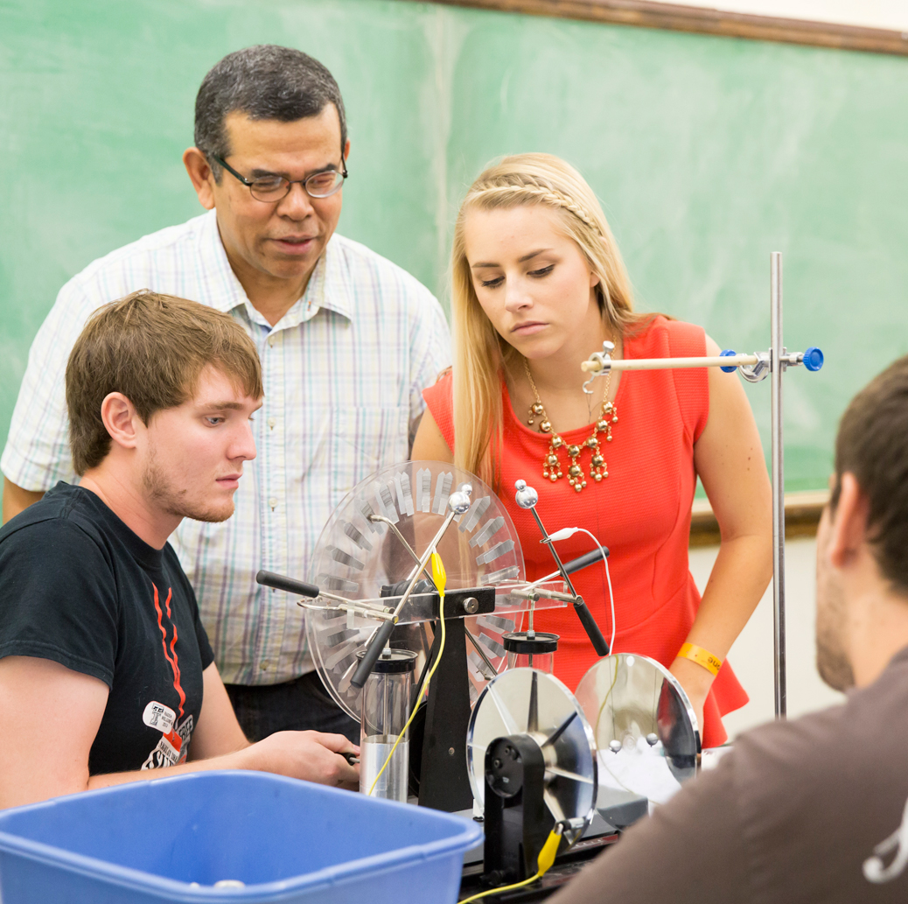
Research - Challenges
Start-ups, post-doctoral students, research faculty to promote continued growth in extramural funding
Federal research funding growth
Improved research infrastructure
Continued legislative support of key Tier 1 research university initiatives (NRUF, CKF, RDF, TRIP)
Continue to create an interdisciplinary, innovative and entrepreneurial culture

Slide 25
Other Challenges
Athletics – Adapt to changing landscape at the national level (specifically messaging , legal and financial changes)
Campus safety and security
Impact of gun legislation
Life safety issues
Lab safety

Slide 26
Goal of 40,000 and the Overall University Enhanced Positioning Nationally
Even with a more conservative trend in enrollment growth, TTU will very likely reach 40,000 by 2020, if not before. TTU can have managed strategic growth based on the following:
Funding and Infrastructure
Enrollment growth essential to receive percentage share of formula funding distribution
Formula funding and designated tuition will provide investment need to continue to become more AAU-like
Added housing planned for fall 2017 will provide sufficient space to expand Living Learning Communities
Goal to increase externally funded research grants will help support graduate students
TTU currently has classroom and office space to accommodate growth (if Tech Plaza and current System space is utilized)
Research space will need to be added based on TRB request and further renovations of existing space
Anticipated increase in HEAF funds will be split between renovations and new faculty start-ups, which will help grow research and creative space related to enhanced national recognitions

