Slide 1

Designing Accessible Graphics & Slides in Canva
Dr. Andrea L. Beaudin, Lecturer
Department of Professional Communication

Slide 2
Poll
Canva Use and Accessibility Practices

Slide 3
Workshop Goals
Identify and analyze accessibility barriers in Canva designs.
Use Canva’s accessibility tools to evaluate and improve accessibility.
Create accessible graphics and slides in Canva.
Avoid or remediate accessibility issues in exported Canva files.

Slide 4
Workshop Overview
Demonstrations of inaccessible materials
Canva accessibility limitations
Design best practices
Evaluating Canva designs for accessibility
Post evaluation and workflow

Slide 5
Impact
How inaccessible content disrupts learning and comprehension

Slide 6

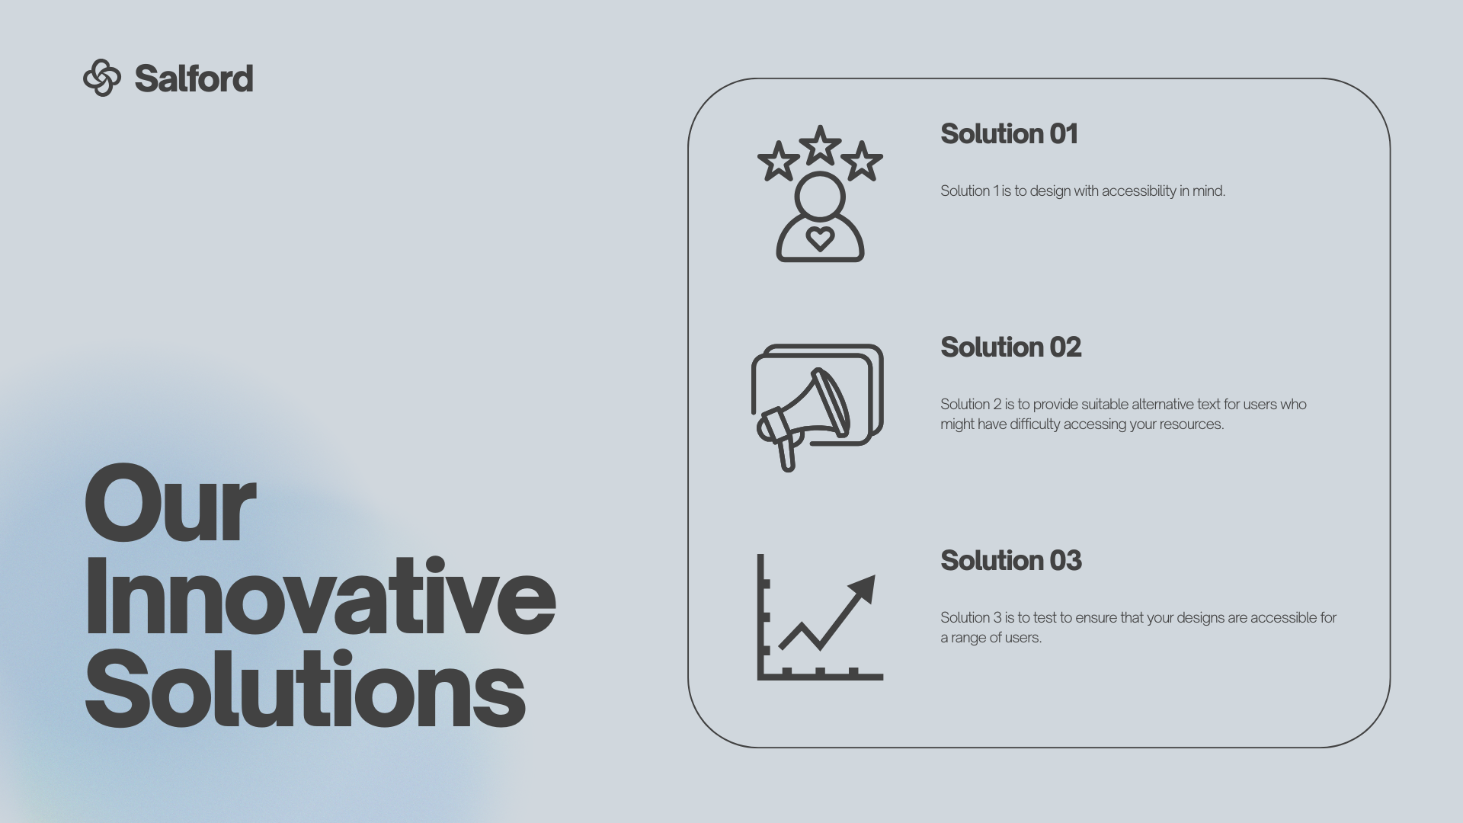
Common Canva Uses
Graphics (often with text)
Presentations

Slide 7
So what’s the problem?
(Accessibility)

Slide 8
Your Audiences Include People…
who are blind or have low vision
with learning or cognitive disabilities
From Digital Accessibility as a Business Practice

Slide 9
Means of Engagement with Visual/Written Content
Assistive Technologies
Workflows
Screen readers and Read-aloud tools
Refreshable Braille displays
Screen magnifiers and zoom tools
High‑contrast modes and color filters
Distraction‑reduction and reading‑mode tools (Reader Mode, focus modes)
Navigating content by headings, structure, and landmarks rather than visually scanning
Using alt text and long descriptions to understand images, charts, and diagrams
Switching to reading modes or linearized text views for simplified reading
Zooming or magnifying content and adjusting spacing for readability
Depending on consistent interface layouts/predictable slide structure
Using text‑to‑speech to read content aloud
Simplifying the view using focus mode
Accessing data tables or written summaries instead of interpreting complex visuals

Slide 10

Screen Reader Experience: Presentation
What issues did you notice listening to the slide?

Slide 11
Canva Presentation Issues
(Online and PDF)
Contrast
Text sizing
Reading order
Missing or unnecessary alt text

Slide 12
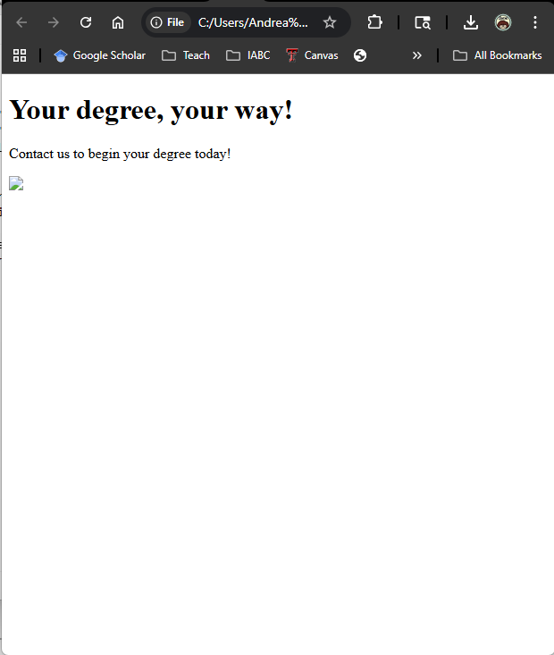
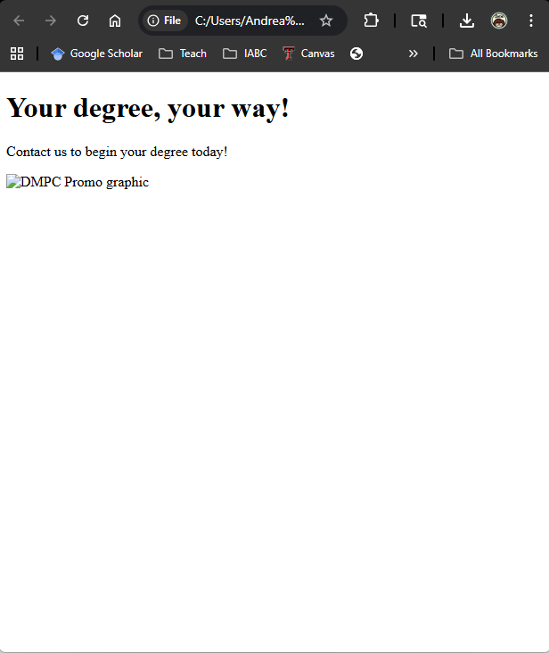
Missing or Poor Alt Text
No Alt Text
Poor Alt Text

Slide 13
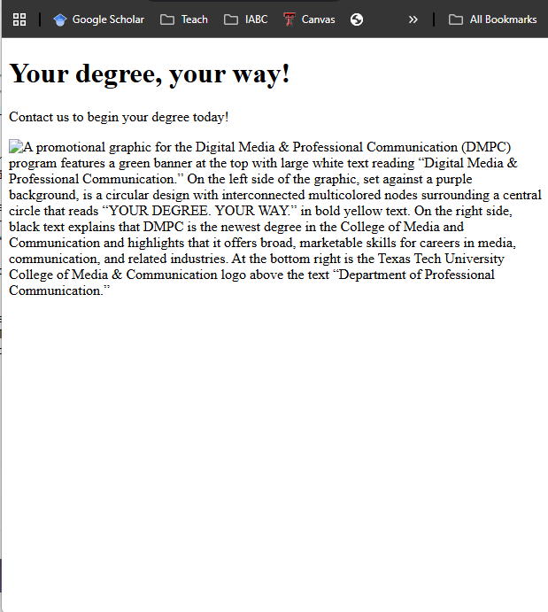
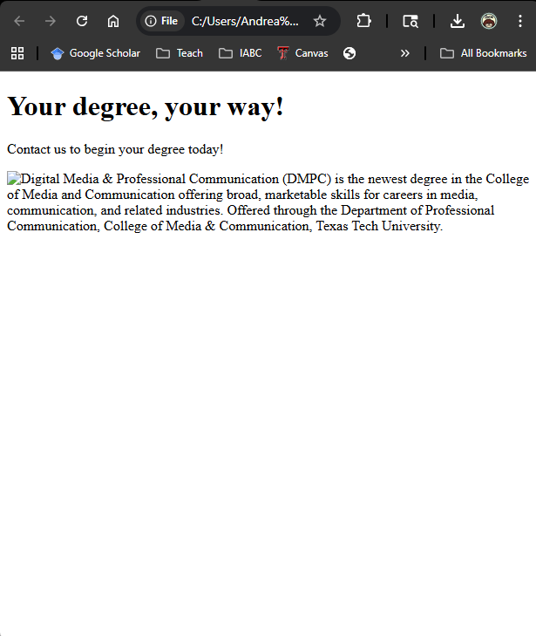
Comprehensive or Relevant Alt Text
Comprehensive Alt Text
Relevant Alt Text

Slide 14
Original Graphic (for Reference)

Slide 15


Poor Contrast Example
Original Graphic
Appearance to someone with total colorblindness

Slide 16
Avoiding or Fixing Accessibility Issues
Canva Presentations and Graphics

Slide 17
For Visual Design, Accessibility Means…
Make Content Perceivable
Provide text alternatives for relevant images, icons, and charts
Avoid images of text; use real text
Ensure high color contrast
Use clear, readable text (avoid full justification)
Keep Content Clear
Use logical heading structure
Avoid clutter and unnecessary complexity
Ensure Predictable Navigation
Keep navigation consistent
Use descriptive link text
Ensure logical reading and tab order
Support Resize and Reflow
Ensure content reflows when zoomed
Ensure content remains readable when zoomed

Slide 18
Canva Graphics: Embedded vs Exported
Embedded/Linked
Exported
Format: iFrame or Link
  + Retain alt text and structural elements
  + Works with screen readers
  - May not render correctly in some platforms
  - Not feasible for social media posts
Format: Image or PDF
  + Usable on multiple platforms
  Image Alt text must be recreated
  + PDF Alt text often exports

Slide 19
Best Practices
Know your output
  Embedding or PDF requires using Canva for alt text, reading order, and structure.
  Images will require you to add alt text following the platform’s process (different for Instagram, Facebook, Canvas, Word, etc.)
Use high contrast colors
  Check contrast in Canva & Silktide
  4.5:1 for most text; 3:1 for large scale (such as titles and headings)
Avoid text over busy images
Ensure body text is at a minimum 16 px font size (recommended)
Use readable typefaces (avoid SCRIPT IN CAPS or Decorative Typefaces for Body Text)

Slide 20
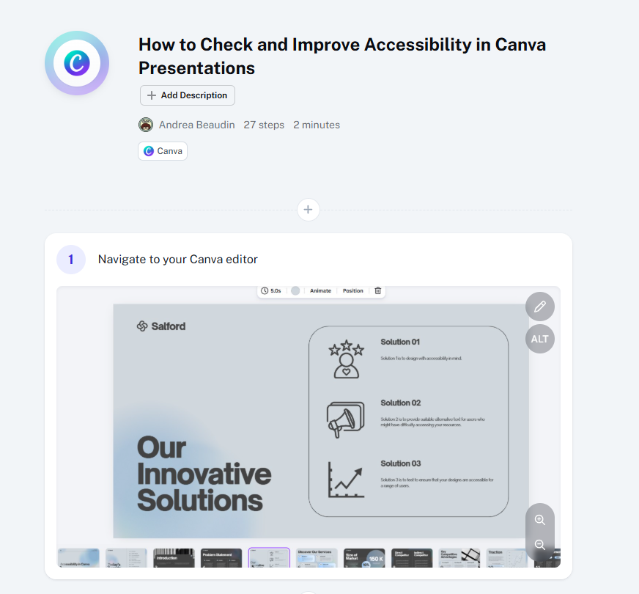
Identifying and Fixing Accessibility Issues in Canva Presentations (Demonstration)
How to Check and Improve Accessibility in Canva Presentations: A Step-by-Step Guide

Slide 21
Exporting Your Presentation as a PDF
Use the Canva accessibility tool to identify and fix possible errors. [Walkthrough]
In Canva
  Click Share
  Click “Download”
  Select PDF Standard
  Uncheck 'Flatten PDF'
  Set language & text semantics
In Acrobat (Full version, not Reader)
  Open PDF
  Run Accessibility check
  Fix any errors
    headings & tags
    reading order
    missing metadata

Slide 22
Image Exports
Alt text must be entered in the platform (does not transfer from Canva)

Slide 23
Q&A
What questions do you have?

