Slide 1
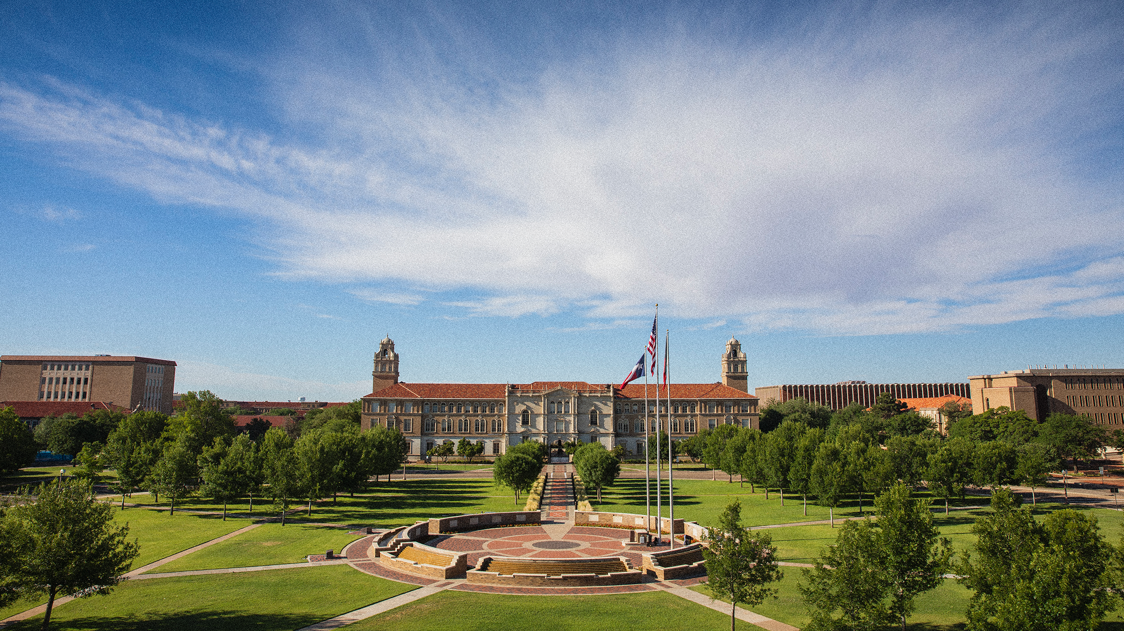

DIGITAL ACCESSIBILITY IN CANVAS

Slide 2
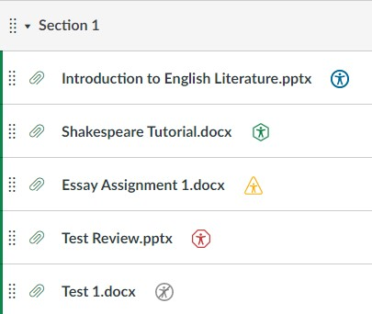

IDENTIFYING ISSUES WITH PANORAMA
Panorama Icons: Located next to every file and page in Canvas.
Red Hexagon: Severe issues (Image-only PDFs, no Alt-Text).
Yellow Triangle: Major issues (Contrast, structural errors).
Green Circle: Accessible (70% score or higher).

Slide 3

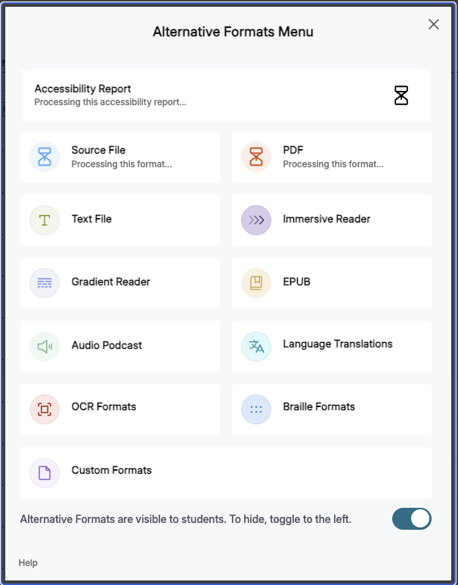
PROVIDING IMMEDIATE ACCESS (THE BLUE ICON)
The Instant "Fix": While you work through your "Red Icon" triage, the Blue Circle Icon provides students with immediate, accessible alternatives.
Student Empowerment: Panorama allows students to convert your existing documents into the format that fits their learning needs:
  Audio (MP3): For students who need to listen while commuting or working.
  BeeLine Reader: Adds color gradients to text to improve focus and reading speed (excellent for ADHD/Dyslexia).
  Electronic Braille & ePub: Critical for students using assistive technology.

Slide 4
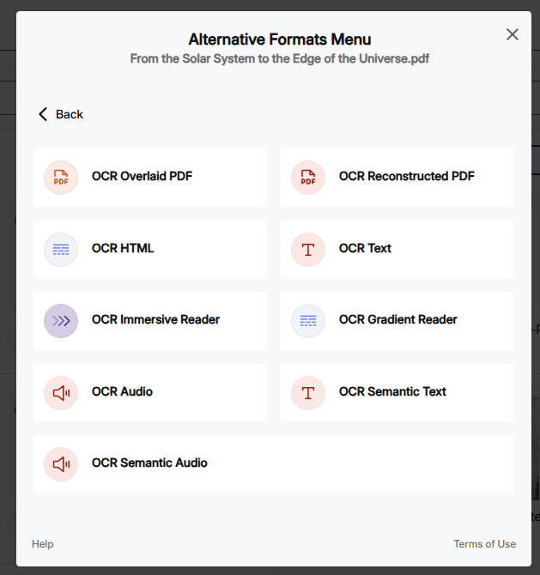
Fixing Scanned PDFs
The Problem: Scanned PDFs are just images; screen readers can't "see" the text.
The Panorama Fix:
  Click the Red Icon to access the Accessibility Report.
  Use the OCR Tool (Optical Character Recognition) to convert the image to text.
  Click "Replace Original" to update the file instantly.

Slide 5
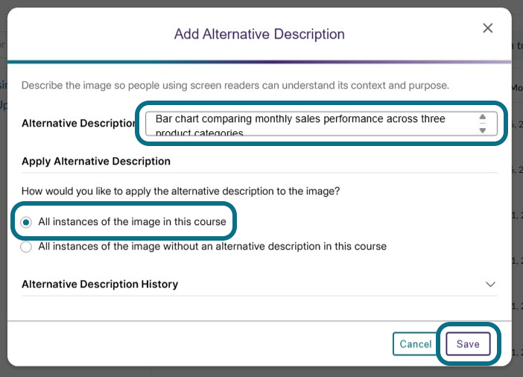
Instant Image Descriptions (Alt-Text)
The Problem: Images without "Alt-Text" leave students with visual impairments in the dark.
The Panorama Fix:
  Click the Panorama icon on any Canvas page.
  Use Inline Remediation to type a 1-2 sentence description.
  Click Save, the description is added to the HTML automatically.

Slide 6
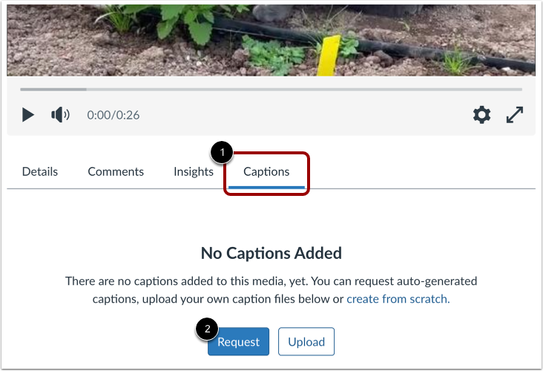
Rapid Video Captioning with Canvas Studio
The Rule: If a student can’t hear the video, they must be able to read it.
The Workflow:
  Upload video to Canvas Studio.
  Click Captions, Request, English.
  Review and Publish: Once generated, do a quick "triage edit" for technical terms and hit publish.

Slide 7
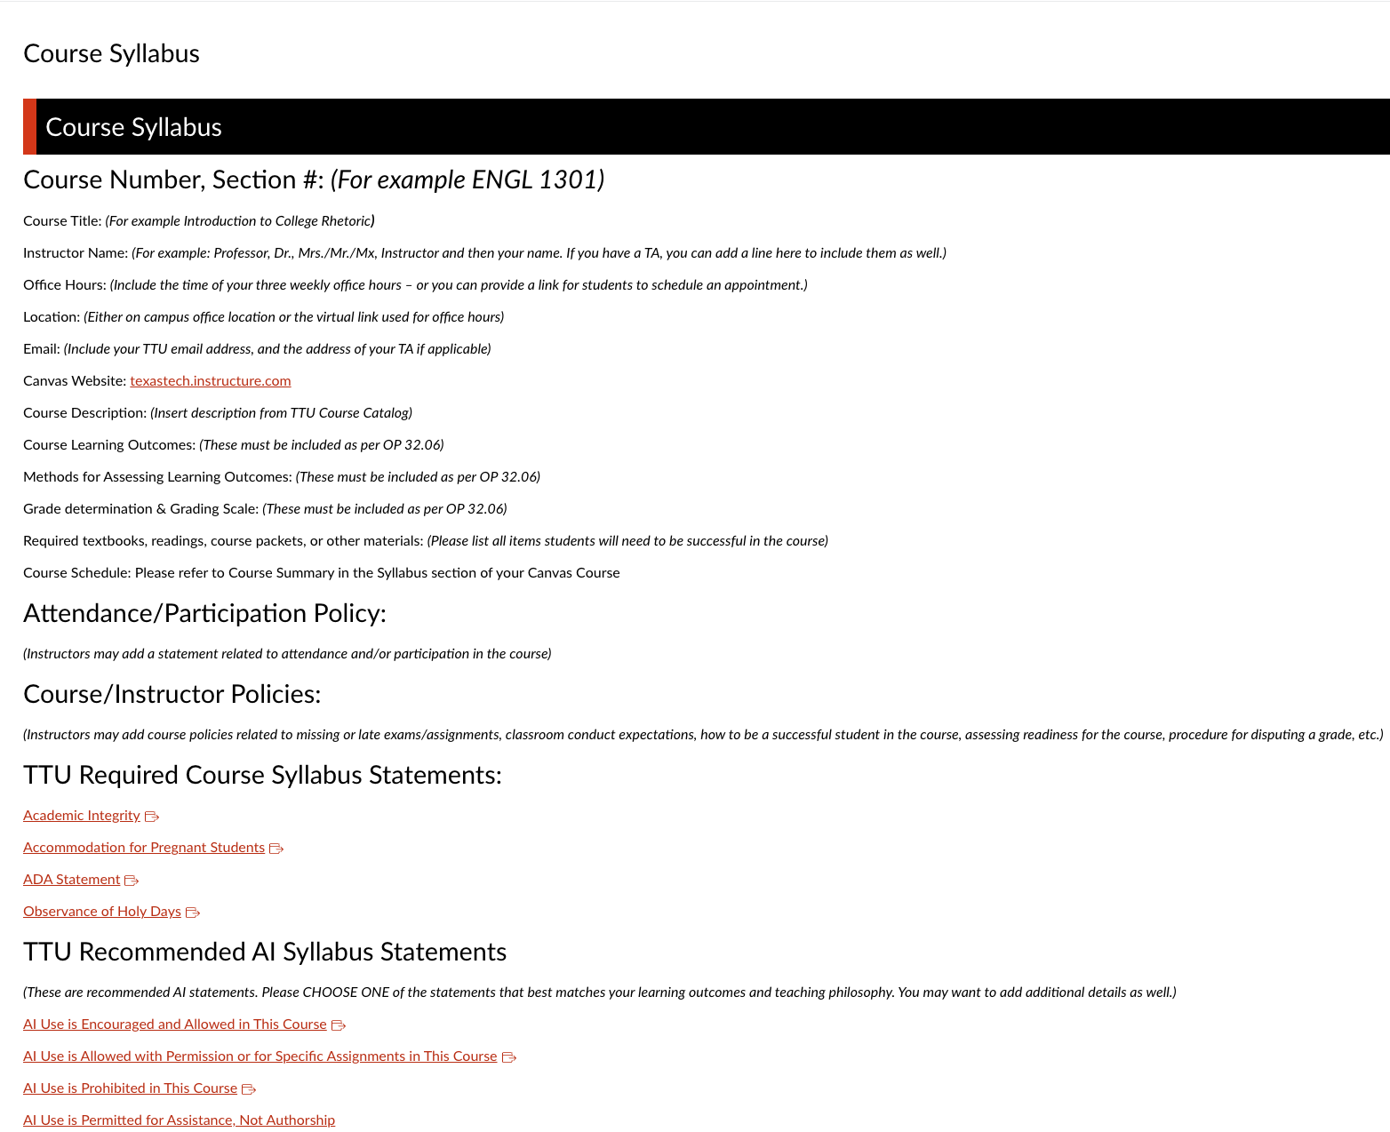
Canvas and Syllabi
Use the Canvas Template
  The Change: Move syllabus content directly into the Canvas Syllabus Tool instead of only uploading a file.
  The Payoff: Instant mobile responsiveness and 100% screen-reader compatibility.
The Panorama “Quick Fix”:
  The Action: Click the Accessibility Icon next to your syllabus file.
  The Fix: Use the AutoPilot tool to instantly remediate common issues like missing headers, low contrast, or font size.
  The Result: A higher accessibility score without re-editing the original document.
Enable Alternative Formats
  The Action: Ensure students can see the Blue Panorama Icon next to your files.
  The Benefit: This allows students to instantly convert your syllabus into a Podcast, Electronic Braille, or OCR PDF.

Slide 8
Who to Contact
DIY Fixes: Use Panorama for PDFs and Canvas Studio for video captions.
Complex Files: If a PDF has complex tables or math, send it to Online Accessibility.
Video Pro-Service: For high-stakes, long-form videos, submit a Captioning Request to Student Disability Services (SDS).

Slide 9

Next Steps and Resources
TTU Online Accessibility: [Link/Email] for course reviews.
eLearning & Academic Partnerships: Support for instructional design
Open your highest-enrollment Canvas course today and fix just 3 Red Icons.

