Slide 1
HSI & Title V Progress
President M. Duane Nellis
Meeting of the Board of Regents
May 15, 2015

Slide 2
Road to HSI/ Title V Status
HSI status is distinct, but necessary for Eligibility in the Title V Program (grant)
Other agencies for which HSI status is advantageous include:
U.S. Department of Agriculture/ /National Science Foundation
National Aeronautics and Space Administration/ National Endowment for the Humanities
The Department of Education (ED) defines an HSI as an institution that has an enrollment of undergraduate full-time equivalent (FTE) students that is at least 25 percent Hispanic at the end of the award year (Sept 30th).
Undergraduate FTE HSI/Title V
 | Fall 2010 | Fall 2011 | Fall 2012 | Fall 2013 | Fall 2014 | 5 Year Growth
Hispanic | 3,947 | 4,469 | 4,836 | 5,351 | 6,031 | 52.8%
Total | 24,553 | 25,116 | 25,390 | 25,959 | 27,418 | 11.7%
Hispanic % | 16.1% | 17.8% | 19.0% | 20.6% | 22.0%

Slide 3
Road to Title V Program (grant) Eligibility
To be eligible for the Title V Program (grant), there is additional criteria, including low-income thresholds for 50% of the Hispanic undergraduates at TTU- currently this requirement is met
Currently, the only active ED Title V Program is the, Developing Hispanic-Serving Institutions Program: which has additional criteria, (i.e, 50% low income and 45% Pell eligible students (TTU is currently at 31%- waivers can be requested for this criteria)
Data for an ED Title V Program award is based on Fall FTE reporting
Basis for validity of HSI status is IPEDS data
Of the 409 HSI institutions, approximately 81 are four-year public institutions
For FY 2014, institutions were awarded on average $509,151 annually to expand and enhance their academic offerings, program quality, and institutional stability TO MAINTAIN HSI SUCCESS
Source: Department of Education. (2015, March 25). Developing Hispanic-Serving Institutions Program - Title V. Retrieved from http://www2.ed.gov/programs/idueshsi

Slide 4
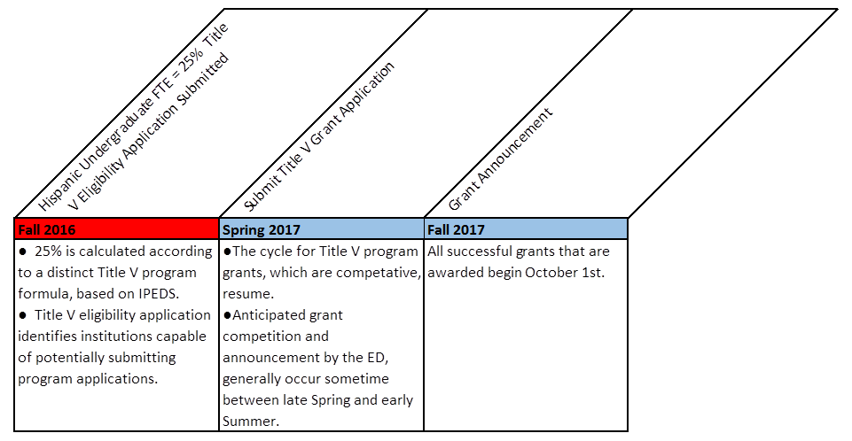
HSI status Title V Program Eligibility Title V Application/Award Timeline

Slide 5
Hispanic Enrollment Compared to Texas AAU Institutions
Texas Tech has increased the proportion of actual Hispanic students by 54% since 2010
Texas Tech has increased the proportion of the overall enrollment of Hispanic students by 6% since 2010
UT Austin has increased the proportion of Hispanic enrollment 2.4% since 2010
Texas A&M has increased the proportion of Hispanic enrollment 5.05% since 2010
Rice University has increased the proportion of Hispanic enrollment 4% since 2010

Slide 6
New Transfer Population

Slide 7
Current Hispanic Recruitment Initiatives
Bilingual admissions counselors in each major Hispanic market
Proactive outreach campaign to admitted Hispanic students
Spanish language admissions website & campus tours
Spanish communication services in all dimensions of recruitment
Recruitment Partnerships with school districts that educate large percentages of academically competitive Hispanic students
Regions of strategic focus include Dallas-Fort Worth/Houston/El Paso and further into South Texas

Slide 8
Additional Recruitment Initiatives
Recruitment Programs
National Hispanic College Fairs in Texas and Colorado
National Hispanic Institute Collegiate World Series Program
Participate in Hispanic College Scholarship Fund Recruitment events
Community Outreach
South Texas Academic Rising Stars Scholarship Fund
Greater Dallas Hispanic Chamber of Commerce Scholarship Program
Region 17 P-20 Council, with South Plains area schools

Slide 9
Projected Hispanic High School Graduates by Region 2015-2024

Slide 10
Undergraduate Admissions Recruitment Staff
5 recruiters
4 recruiters
5 recruiters
1 recruiter
3 recruiters (Austin); 1 recruiter (San Antonio)
1 recruiter

Slide 11
Proposal: Recruitment
Increase Recruiting Events in Targeted Regions
Recruiting Receptions in South Texas Valley
Lower Rio Grande Valley
Corpus Christi
Add Transfer Counselor to DFW Region based on Projected Growth
Add additional staff to CCTR (Community College & Transfer Relations) for the Dallas market
Enhance Spanish Language Communication
Including Spanish Brochure for Parents
Increase out reach by the Office of Parent and Family Relations
More aggressive recruitment of Hispanic students to President’s Select and as ambassadors for role models

Slide 12
Current Hispanic Retention Initiatives
Lauro Cavazos/Ophelia Powell Mentor Program, also known as Mentor Tech:
approximately 700 students, a high number of whom are Hispanic, take part in this college success and personal development program
Pioneers in Education: Generations Achieving Scholarship and Unprecedented Success, also known as PEGASUS:
approximately 600 first generation college students participate in this program to help navigate the unfamiliar terrain of higher education. This group enjoys an higher than average first year retention rate
Cross-Cultural Academic Advancement Center (CCAAC):
serves as a coordination nexus for Hispanic themed faculty, staff and student organizations
Hispanic Scholarship Fund chapter:
TTU currently supports a nationally recognized student chapter of the HSF
Hispanic Sororities & Fraternities are under the umbrella of Multicultural Greek Council
Latino Faculty and Staff programming:
Latino faculty and staff coordinate events, programs, and speakers that serve as magnets and anchors for Hispanic student success at TTU

Slide 13
New Retention Initiatives
Increase staffing and programming funds:
Mentor Tech- increase staff by 1, to add an additional 300 students
PEGASUS- increase staff by 1, to add an additional 200 students
CCAAC- increase programming funds to allow participation in Red Raider Road shows, outreach and recruitment activities
Develop curricular “anchors” such as Mexican American/Hispanic Studies offerings
Create Hispanic/Latino Ambassadors program
Involve Raiders Rojos Alumni group in retention activities
Create new external scholarships to reward retention, persistence and success
Enhance marketing and communications of TTU Hispanic/Latino faculty, staff, & alumni achievements
Increase underrepresented Latina/Hispanic faculty in academic departments and colleges
Future development of a nationally recognized Hispanic/Latino/a Research Center

Slide 14
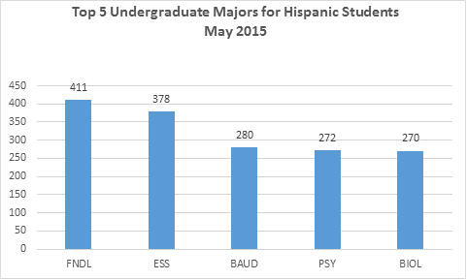
Additional Initiatives
Expand Tech Transfer Acceleration Program to predominately Hispanic-serving area community colleges
EAB-SSC risk markers and timely interventions: work with the academic advisors of the top 5 fields that Hispanics are enrolling in to identify risk early and intervene aggressively to ensure academic attrition does not follow.
Hispanics leadership forum/summit
Latino Education Summit
College/Major-specific cohort sections of Raider Ready by top enrolling majors:
Foundational engineering/exercise sports science
Business undeclared/psychology/biology

Slide 15
Summary: Goals
TTU reaches HSI status by Fall 2016
Title V Eligibility application submitted December 2016
Title V Program Grant application late Spring or Summer 2017
Title V Program grant notification of award October 1st

